Slide 1
Online car rental app
K P BADRI
192111179
CSA3731- SOFTWARE TESTING FOR ANDROID APPLICATONS
DATE :- 31/01/2023

Slide 2
PROJECT DETAILS
objective
abstract
proposed system
flow chart
concept map
test cases
application tools
implementation
test case outcome
conclusion

Slide 3
OBJECTIVE
The app is to make the car booking easy and it gives the option to select the particular car if its available
This app helps in segregate the cars based on the lower level to higher level

Slide 4
ABSTRACT
This app helps in booking rental cars at anytime from your surroundings
This app gives a separate user portal to use it individually
This application is secured and easy to book rental cars
Self driving availability is there if needed

Slide 5
Proposed SYSTEM
In this process we use appium to test this app
We need to need to install intelij idea to create an project and make operations to clone version of app
Then we use the test cases one-by-one and conclude the results to the test cases
After testing we suggest the conclusion that some additional idea implementation in the app

Slide 6
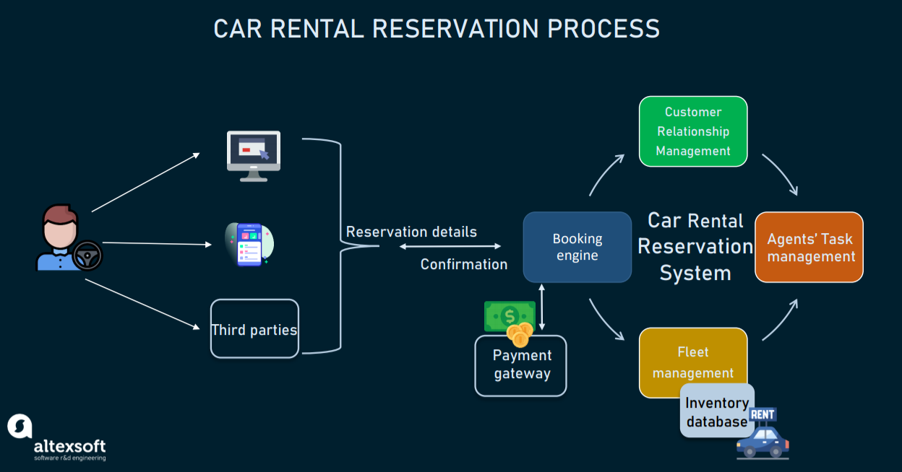
Flow chart

Slide 7
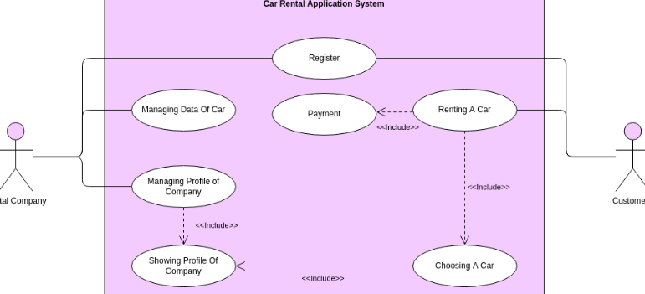
CONCEPT MAP

Slide 8
TEST CASES
test the username is valid or not
test the log in and log out
test the availability of cars
test the payment process for booking
test the assurance of car
test the login password is correct/incorrect
test the message for incorrect password
test the forgot password functionality

Slide 9



APPLICATION TOOLS

Slide 10
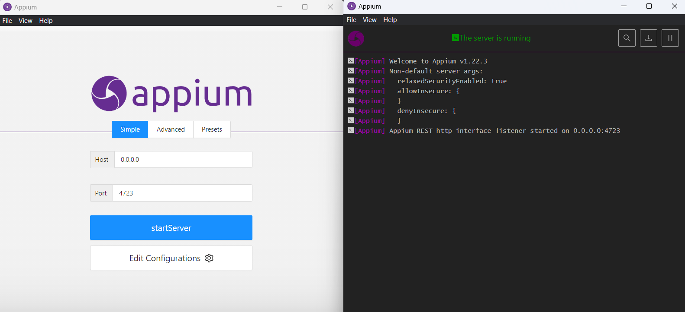
APPIUM SERVER

Slide 11
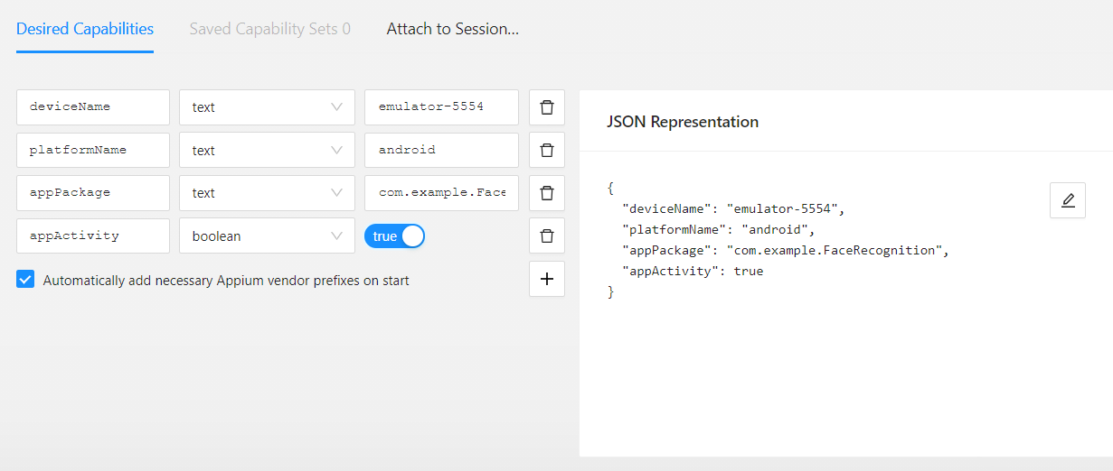
APPIUM SERVER INSPECTOR

Slide 12
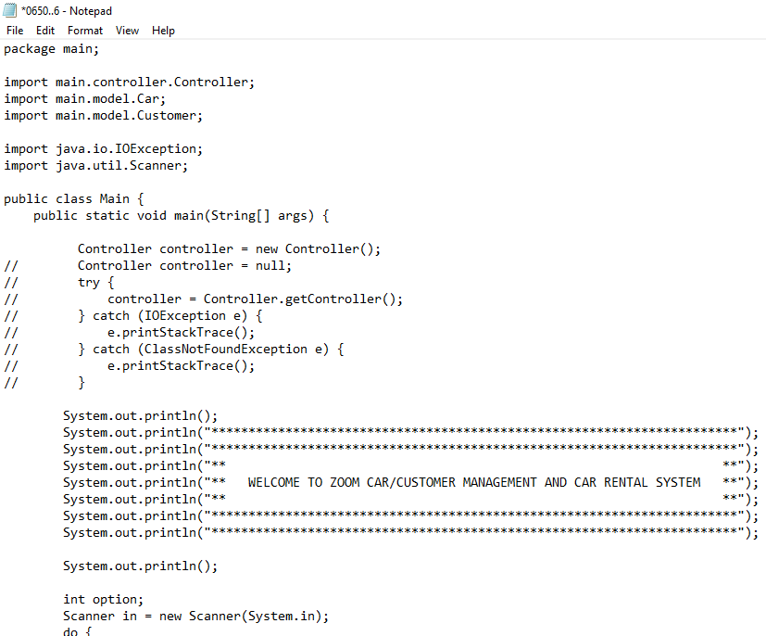
code

Slide 13
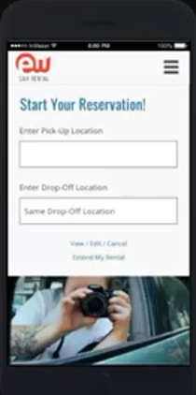
implementation

Slide 14
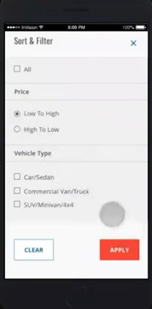

Slide 15
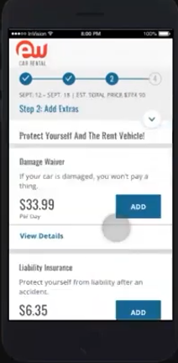

Slide 16
TEST CASE OUTCOMES
Test case | outcome
Verify if a user/admin is able to login with valid username and password | positive
Verify if a user/admin is not able to login with valid username and invalid password | negative
Verify the forgot password functionality | (positive)
Verify the message for invalid login | (positive)
Verify the not remember me functionality | (negative)
Verify if user is able to login with a new password only after he/she changed the password | (negative)
Verify the admin is able to select cars | (positive)
Verify the user is able to see available cars | (positive)

Slide 17
conclusion
The testing of rental car app has been executed succesfully and after testing all the “test cases”it has been working good with user friendly environment
From the above testing, we can conclude the working abilities of the rental car app and relaiabilty of the app

